Slide 1
The Role of Business Intelligence Tools in Economic Decision-Making
National Student Scientific Session — “Digital Economy and Society”
Ion Mateo Andrei
Student, Year I, Economic Informatics
Petroleum-Gas University of Ploiești,
Faculty of Economic Sciences
Coordinating Professor:
November 2026
Lect. univ. dr. Ana Maria Teodorescu

Slide 2
The Economic Problem: What Global Figures Hide
2.30M
286K
total sales
total profit (12.5% margin)
•
Dataset: Superstore, 9,994 transactions
Vanzari_Totale
Profit_Total
Marja_Profit_Medie
•
At first glance: a healthy and profitable business
2.30M
286.40K
12.47%
•
Aggregate figures hide losses in specific products and cities
•
BI Solution: drill-down from total to category, subcategory, and month
2

Slide 3
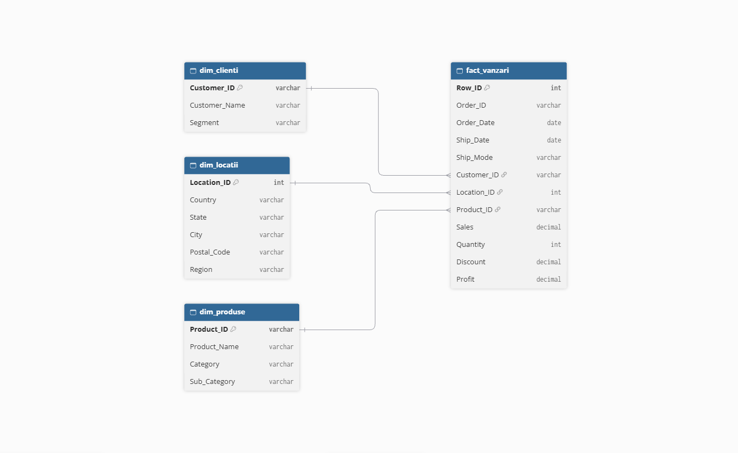
Data Infrastructure: Star Schema in MySQL
•
MySQL Community Server 26.7.0
•
database: datashop
•
0 null values in key fields
•
dates converted with STR_TO_DATE
3

Slide 4
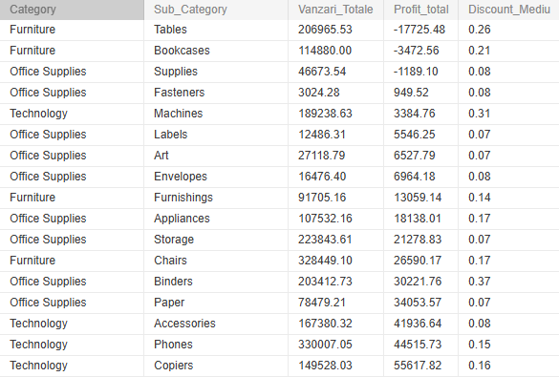
SQL Validation: Where Is Profit Lost?
SQL QUERY
select
dp.Category,
dp.Sub_Category,
round(sum(sales),2) as Vanzari_Totale,
round(sum(Profit),2) as Profit_total,
round(avg(Discount),2) as Discount_Mediu
from dim_produse dp
join fact_vanzari fv on fv.Product_ID=dp.Product_ID
Group by dp.Category,dp.Sub_Category
order by round(sum(Profit),2)
•
Furniture: 742K sales, profit only 18.5K
•
Profit margin 2.5%, compared to 12.5% overall
•
3 loss-making subcategories: Tables, Bookcases, Supplies
4

Slide 5
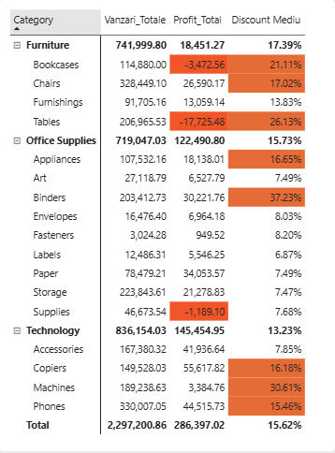
Drill-down: Furniture → Tables
206,965
sales $ (9.0% of total)
-17,725
profit $ — the largest loss
26.13%
average discount (vs. 15.62% total)
5

Slide 6
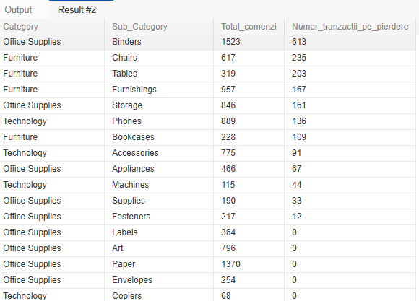
SQL Validation: The Loss Is Systematic
SQL QUERY
SELECT
dp.Category,
dp.Sub_Category,
count(*) as Total_comenzi,
sum(case
when fv.profit<0 then 1
else 0
end) as Numar_tranzactii_pe_pierdere
from dim_produse dp
join fact_vanzari fv on fv.Product_ID=dp.Product_ID
Group by dp.Category,dp.Sub_Category
order by Numar_tranzactii_pe_pierdere DESC
63.6%
of Tables orders (203 out of 319) are at a loss
18.7%
average across all transactions (1,871 out of 9,994)
6

Slide 7
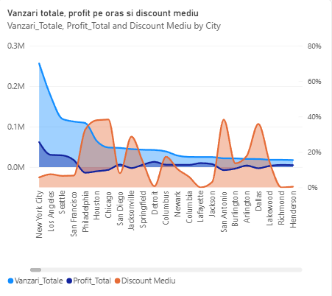
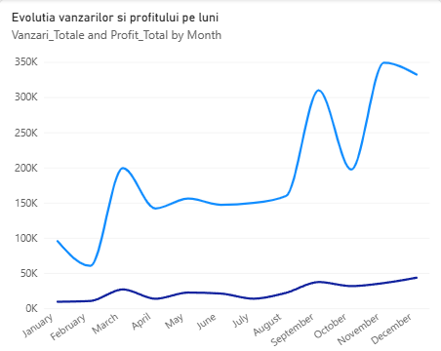
Seasonality and Loss-Making Cities
43%
Philadelphia: -$13.8K
Why? 33–38% average discount in these cities, compared to ~6% in New York
of sales in just 3 months: September, November, December
5th city by sales ($109K), but at a loss; same for Houston and Chicago
7

Slide 8
Decision-Making Foundation: Managerial Recommendations
What the data shows: Tables and discounts over 20% generate losses; 63.6% of Tables orders are negative; Philadelphia, Houston, and Chicago are at a loss
1
2
Decision 1
Decision 2
Capping Discounts on Tables
Revising Discounts by City
average discount 26.13%; for discounts over 20% the loss is $36K–$100K
Philadelphia, Houston, Chicago: 33–38% average discount and negative profit
8

Slide 9


Conclusions and Live Demonstration
•
Positive global figures can hide significant losses
•
The Star Schema in MySQL provided a clean and organized database
•
SQL queries confirmed the results from the dashboard
•
Interactive drill-down revealed the anomalies
•
Dashboard QR Code
Business Intelligence transforms raw data into informed decisions
Bibliography: Fictional database source website:
https://www.kaggle.com/datasets/ishanshrivastava28/superstore-sales

